Slide 1
ENGINEERING (yourself)
START WITH THE END IN MIND, Stephen Covey, The 7 habits of highly effective people https://www.stephencovey.com/7habits/7habits-habit2.php
https://www.youtube.com/watch?v=Gohgjn95LU4 (song)
‘We are stubborn on vision, we are flexible on details” Jeff Bezos, founder of Amazon.com
“The world is messed up, but I can fix it”, Steve Balmer, former CEO at Microsoft
LET YOUR VISION SET YOUR GOALS.
AUG 9th, 2016 - DR. MADARO

Slide 2
Dream it, plan it, then do it!
YOUR LIFE
YOUR CAREER
YOUR SCHOOL
YOUR DAY

Slide 3
Pick a life style, dream big!
What do you value now and in your future?
Time, friends, family, money, a boat, a supercar, excellent food, traffic, rural, office, working outside, travel…..
Keep looking, do not settle https://www.youtube.com/watch?v=o5ZEgPIoZjw

Slide 4
Pick a Career
http://www.careercornerstone.org/engineering/engdisc.htm
https://www.youtube.com/watch?v=OuUh_2vhTeQ (motivation)
https://www.youtube.com/watch?v=bipTWWHya8A (what is engineering)

Slide 5
Pick the School
http://engineering-schools.startclass.com/
http://admission.universityofcalifornia.edu/campuses/
http://www.calstate.edu/search_find/campus.shtml

Slide 6
Engineering programs at Butte College
Engineering at Butte College
http://www.butte.edu/curriculum/degrees_and_programs/
http://www.butte.edu/curriculum/degrees_and_programs/program_details.php?year=5&program_id=495
http://www.butte.edu/curriculum/degrees_and_programs/program_details.php?year=5&program_id=508

Slide 7
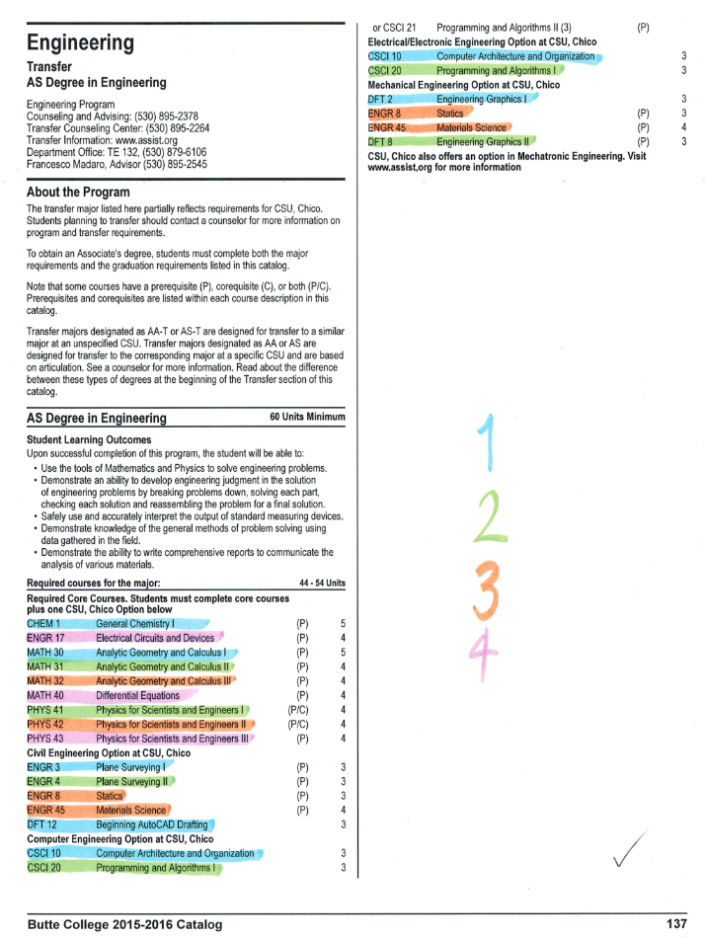
Plan your academic career Be a professional student!
Assist.org
C-id.net

Slide 8
Activity: make your study plan
Life style
Career
University
Community college
Plan of study at community college
This very semester and the next 3.

Slide 9
Sign up for classes!
Admission and records
Dual enrollment with CSU, Chico

Slide 10
Manage your time
Friends
Sports
Food
Love
Work
School!
https://www.intelligent.com/
Day plan www.monash.edu.au/lls/llonline/quickrefs/02b-blank-timetable.doc

Slide 11
Model for a study road map

Slide 12
Best wishes and…..
Join our Engineering Club!
http://engineeringbuttecollege.weebly.com/engineering-club.html

